Slide 1
Employee Data Analysis using Excel
STUDENT NAME:Sandhiya.D
REGISTER NO:312216802
DEPARTMENT:B.Com Accounting and Finance
COLLEGE:Shri Krishnaswamy College for women

Slide 2
PROJECT TITLE
Employee Performance Analysis using Excel

Slide 3


AGENDA
Problem Statement
Project Overview
End Users
Our Solution and Proposition
Dataset Description
Modelling Approach
Results and Discussion
Conclusion
3/21/2024 Annual Review

Slide 4


PROBLEM STATEMENT

Slide 5
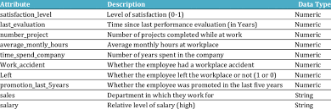

PROJECT OVERVIEW
.

Slide 6


WHO ARE THE END USERS?

Slide 7


OUR SOLUTION AND ITS VALUE PROPOSITION

Slide 8

Dataset Description

Slide 9
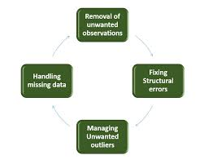
MODELLING
9

Slide 10
RESULTS
10

Slide 11

conclusion
From the results, we can conclude that the company should provide a better environment as it increases the performance drastically. The company should increase the salary of the employee from time to time and help them maintain a worklife balance. On the other hand, shuffling the manager from time to time will also affect performance.

